Slide 1
Digital Logic and Design
Lecture No. 10
Notes:
‹#›

Slide 2
Karnaugh Map
Simplification of Boolean Expressions
Doesn’t guarantee simplest form of expression
Terms are not obvious
Skills of applying rules and laws
K-map provides a systematic method
An array of cells
Used for simplifying 2, 3, 4 and 5 variable expressions

Slide 3
3-Variable K-map
AB\C | 0 | 1
00 | 0 | 1
01 | 2 | 3
11 | 6 | 7
10 | 4 | 5
A\BC | 00 | 01 | 11 | 10
0 | 0 | 1 | 3 | 2
1 | 4 | 5 | 7 | 6
Notes:
‹#›
The 3 variable K-map has 8 cells.
The 8 cells can be arranged in 2 columns and 4 rows representing the column form of the Karnaugh Map
Alternately the 8 cells can be organized in 2 rows and 4 columns representing the row form of the Karnaugh map.
Any of the two forms of the Karnaugh Map can be used to simplify Boolean expressions.
The simplified expressions using either of the two K-maps are identical.
Considering first the column based 3-variable Karnuagh map.
The binary values 00, 01, 11 and 10 in the left most column of the K-map represent the binary values of variables A and B
The binary values 0 and 1 in the top row of the K-map represents the binary values of variable C.
The 8 cells marked with numbers 0 to 7 represent the cells 0 to 7 corresponding to the minterms 0 to 7 or the maxterms 0 to 7 in a 3 variable Boolean expression.
The cell marked 0 for example, represents the minterm 0 or the maxterm 0 having binary value of variables A, B and C equal to 000.
Similarly cell marked 5 represents the minterm 5 or the maxterm 5 having binary values of variables A, B and C equal to 101.
The 3-variable K-Map based on the row representation is considered next.
The binary values 0 and 1 in the left most column of the K-map represent the binary values of variable A.
The binary values 00, 01, 11 and 10 in the top row of the K-map represent the binary values of variables B and C
The 8 cells marked with numbers 0 to 7 represent the cells 0 to 7 corresponding to the minterms 0 to 7 or the maxterms 0 to 7 in a 3 variable Boolean expression.
The cell marked 1 for example, represents the minterm 1 or the maxterm 1 having binary value of variables A, B and C equal to 001.
Similarly cell marked 7 represents the minterm 7 or the maxterm 7 having binary values of variables A, B and C equal to 111.

Slide 4
4-Variable K-map
AB\CD | 00 | 01 | 11 | 10
00 | 0 | 1 | 3 | 2
01 | 4 | 5 | 7 | 6
11 | 12 | 13 | 15 | 14
10 | 8 | 9 | 11 | 10
Notes:
‹#›
The 4-variable K-Map has a square format with four rows and four columns of cells.
The binary values 00, 01, 11 and 10 in the left most column of the K-map represent the binary values of variables A and B
The binary values 00, 01, 11 and 10 in the top row of the K-map represents the binary values of variables C and D
The 16 cells marked with numbers 0 to 15 represent the cells 0 to 15 corresponding to the minterms 0 to 15 or the maxterms 0 to 15 in a 4 variable Boolean expression.
The cell marked 6 for example, represents the minterm 6 or the maxterm 6 having binary value of variables A, B, C and D equal to 0110
Similarly cell marked 13 represents the minterm 13 or the maxterm 13 having binary values of variables A, B, C and D equal to 1101.

Slide 5
Grouping & Adjacent Cells
K-map is considered to be wrapped around
All sides are adjacent to each other
Groups of 2, 4, 8,16 and 32 adjacent cells are formed
Groups can be row, column, square or rectangular.
Groups of diagonal cells are not allowed

Slide 6
Mapping of Standard SOP expression
Selecting n-variable K-map
1 marked in cell for each minterm
Remaining cells marked with 0

Slide 7

Mapping of Standard SOP expression
SOP expression
AB\C | 0 | 1
00
01
11
10
A\BC | 00 | 01 | 11 | 10
0
1
Notes:
‹#›
Consider the 3-variable standard SOP expression ABC*+AB*C*+A*BC*
A 3-variable K-map is used to map the expression as the SOP expression has a domain of 3 variables.
What are the minterms in the SOP expression?
The Standard SOP expression has three minterms 2, 4 and 6.
The minterms present in the expression are mapped to the corresponding K-map cells.
The cells representing the three minterms are marked with 1s, remaining cells are marked with 0s.
Any of the two K-maps can be used

Slide 8
Mapping of Standard SOP expression
SOP expression
AB\C | 0 | 1
00
01
11 | 1
10
A\BC | 00 | 01 | 11 | 10
0
1 |  |  |  | 1
Notes:
‹#›
Consider the 3-variable standard SOP expression ABC*+AB*C*+A*BC*
A 3-variable K-map is used to map the expression as the SOP expression has a domain of 3 variables.
What are the minterms in the SOP expression?
The Standard SOP expression has three minterms 2, 4 and 6.
The minterms present in the expression are mapped to the corresponding K-map cells.
The cells representing the three minterms are marked with 1s, remaining cells are marked with 0s.
Any of the two K-maps can be used

Slide 9
Mapping of Standard SOP expression
SOP expression
AB\C | 0 | 1
00
01
11 | 1
10 | 1
A\BC | 00 | 01 | 11 | 10
0
1 | 1 |  |  | 1
Notes:
‹#›
Consider the 3-variable standard SOP expression ABC*+AB*C*+A*BC*
A 3-variable K-map is used to map the expression as the SOP expression has a domain of 3 variables.
What are the minterms in the SOP expression?
The Standard SOP expression has three minterms 2, 4 and 6.
The minterms present in the expression are mapped to the corresponding K-map cells.
The cells representing the three minterms are marked with 1s, remaining cells are marked with 0s.
Any of the two K-maps can be used

Slide 10
Mapping of Standard SOP expression
SOP expression
AB\C | 0 | 1
00
01 | 1
11 | 1
10 | 1
A\BC | 00 | 01 | 11 | 10
0 |  |  |  | 1
1 | 1 |  |  | 1
Notes:
‹#›
Consider the 3-variable standard SOP expression ABC*+AB*C*+A*BC*
A 3-variable K-map is used to map the expression as the SOP expression has a domain of 3 variables.
What are the minterms in the SOP expression?
The Standard SOP expression has three minterms 2, 4 and 6.
The minterms present in the expression are mapped to the corresponding K-map cells.
The cells representing the three minterms are marked with 1s, remaining cells are marked with 0s.
Any of the two K-maps can be used

Slide 11
Mapping of Standard SOP expression
SOP expression
AB\C | 0 | 1
00 | 0 | 0
01 | 1 | 0
11 | 1 | 0
10 | 1 | 0
A\BC | 00 | 01 | 11 | 10
0 | 0 | 0 | 0 | 1
1 | 1 | 0 | 0 | 1
Notes:
‹#›
Consider the 3-variable standard SOP expression ABC*+AB*C*+A*BC*
A 3-variable K-map is used to map the expression as the SOP expression has a domain of 3 variables.
What are the minterms in the SOP expression?
The Standard SOP expression has three minterms 2, 4 and 6.
The minterms present in the expression are mapped to the corresponding K-map cells.
The cells representing the three minterms are marked with 1s, remaining cells are marked with 0s.
Any of the two K-maps can be used

Slide 12
Mapping of Standard SOP expression
SOP expression
AB\CD | 00 | 01 | 11 | 10
00
01
11
10
Notes:
‹#›
Consider the 4-variable SOP expression having the 7 sum terms.
A 4-variable K-map is used as the SOP expression has a domain of 4 variables.
What are the minterms in the SOP expression?
The Standard SOP expression has seven minterms 1, 4, 5, 6, 8, 13 and 14
The minterms present in the expression are mapped to the corresponding K-map cells.
The cells representing the 7 minterms are marked with 1s, remaining cells are marked with 0s.

Slide 13
Mapping of Standard SOP expression
SOP expression
AB\CD | 00 | 01 | 11 | 10
00
01
11
10
Notes:
‹#›
Consider the 4-variable SOP expression having the 7 sum terms.
A 4-variable K-map is used as the SOP expression has a domain of 4 variables.
What are the minterms in the SOP expression?
The Standard SOP expression has seven minterms 1, 4, 5, 6, 8, 13 and 14
The minterms present in the expression are mapped to the corresponding K-map cells.
The cells representing the 7 minterms are marked with 1s, remaining cells are marked with 0s.

Slide 14
Mapping of Standard SOP expression
SOP expression
AB\CD | 00 | 01 | 11 | 10
00 |  | 1
01 | 1 | 1 |  | 1
11 |  | 1 |  | 1
10 | 1
Notes:
‹#›
Consider the 4-variable SOP expression having the 7 sum terms.
A 4-variable K-map is used as the SOP expression has a domain of 4 variables.
What are the minterms in the SOP expression?
The Standard SOP expression has seven minterms 1, 4, 5, 6, 8, 13 and 14
The minterms present in the expression are mapped to the corresponding K-map cells.
The cells representing the 7 minterms are marked with 1s, remaining cells are marked with 0s.

Slide 15
Mapping of Standard SOP expression
SOP expression
AB\CD | 00 | 01 | 11 | 10
00 | 0 | 1 | 0 | 0
01 | 1 | 1 | 0 | 1
11 | 0 | 1 | 0 | 1
10 | 1 | 0 | 0 | 0
Notes:
‹#›
Consider the 4-variable SOP expression having the 7 sum terms.
A 4-variable K-map is used as the SOP expression has a domain of 4 variables.
What are the minterms in the SOP expression?
The Standard SOP expression has seven minterms 1, 4, 5, 6, 8, 13 and 14
The minterms present in the expression are mapped to the corresponding K-map cells.
The cells representing the 7 minterms are marked with 1s, remaining cells are marked with 0s.

Slide 16
Mapping of Non-Standard SOP expression
Selecting n-variable K-map
1 marked in all the cells where the non- standard product term is present
Remaining cells marked with 0

Slide 17
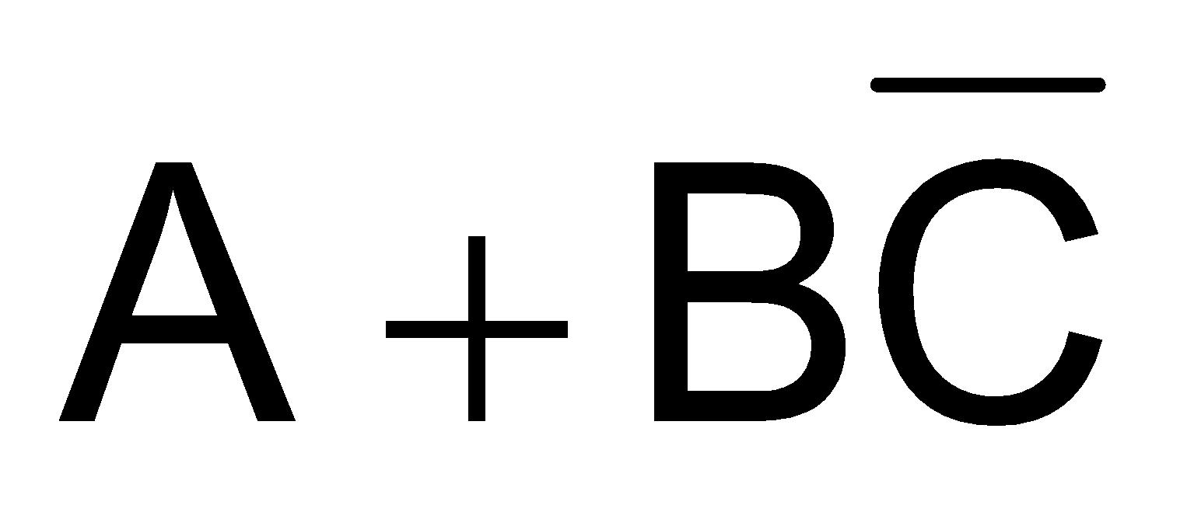
Mapping of Non-Standard SOP expression
SOP expression
AB\C | 0 | 1
00
01
11
10
A\BC | 00 | 01 | 11 | 10
0
1
Notes:
‹#›
Consider the non-standard SOP expression A+BC*
A 3-variable K-map is used as the SOP expression has a domain of 3 variables.
Any of the two K-maps representations, that is column or row representation can be used
The non-standard product term A is mapped first.
The 3 variable K-map cells having the term A are marked with 1s.
The cells marked 4, 5, 6 and 7 all have the term A, therefore these cells are marked with 1s

Slide 18
Mapping of Non-Standard SOP expression
SOP expression
AB\C | 0 | 1
00
01
11 | 1 | 1
10 | 1 | 1
A\BC | 00 | 01 | 11 | 10
0
1 | 1 | 1 | 1 | 1
Notes:
‹#›
Consider the non-standard SOP expression A+BC*
A 3-variable K-map is used as the SOP expression has a domain of 3 variables.
Any of the two K-maps representations, that is column or row representation can be used
The non-standard product term A is mapped first.
The 3 variable K-map cells having the term A are marked with 1s.
The cells marked 4, 5, 6 and 7 all have the term A, therefore these cells are marked with 1s

Slide 19
Mapping of Non-Standard SOP expression
SOP expression
AB\C | 0 | 1
00
01
11 | 1 | 1
10 | 1 | 1
A\BC | 00 | 01 | 11 | 10
0
1 | 1 | 1 | 1 | 1
Notes:
‹#›
Now consider the second non-standard product term BC*
Using the same k-map
The cells marked 2 and 6 are marked with 1s.
Both the cells have the variable BC*
Remaining cells are marked with 0s.
It is possible that multiple terms are present in the same cell, such as the terms A and BC*.
Both the terms are present in cell 6.
Presence of multiple terms in a single cell is marked by a single 1.

Slide 20
Mapping of Non-Standard SOP expression
SOP expression
AB\C | 0 | 1
00
01 | 1
11 | 1 | 1
10 | 1 | 1
A\BC | 00 | 01 | 11 | 10
0 |  |  |  | 1
1 | 1 | 1 | 1 | 1
Notes:
‹#›
Now consider the second non-standard product term BC*
Using the same k-map
The cells marked 2 and 6 are marked with 1s.
Both the cells have the variable BC*
Remaining cells are marked with 0s.
It is possible that multiple terms are present in the same cell, such as the terms A and BC*.
Both the terms are present in cell 6.
Presence of multiple terms in a single cell is marked by a single 1.

Slide 21
Mapping of Non-Standard SOP expression
SOP expression
AB\C | 0 | 1
00 | 0 | 0
01 | 1 | 0
11 | 1 | 1
10 | 1 | 1
A\BC | 00 | 01 | 11 | 10
0 | 0 | 0 | 0 | 1
1 | 1 | 1 | 1 | 1
Notes:
‹#›
Now consider the second non-standard product term BC*
Using the same k-map
The cells marked 2 and 6 are marked with 1s.
Both the cells have the variable BC*
Remaining cells are marked with 0s.
It is possible that multiple terms are present in the same cell, such as the terms A and BC*.
Both the terms are present in cell 6.
Presence of multiple terms in a single cell is marked by a single 1.

Slide 22
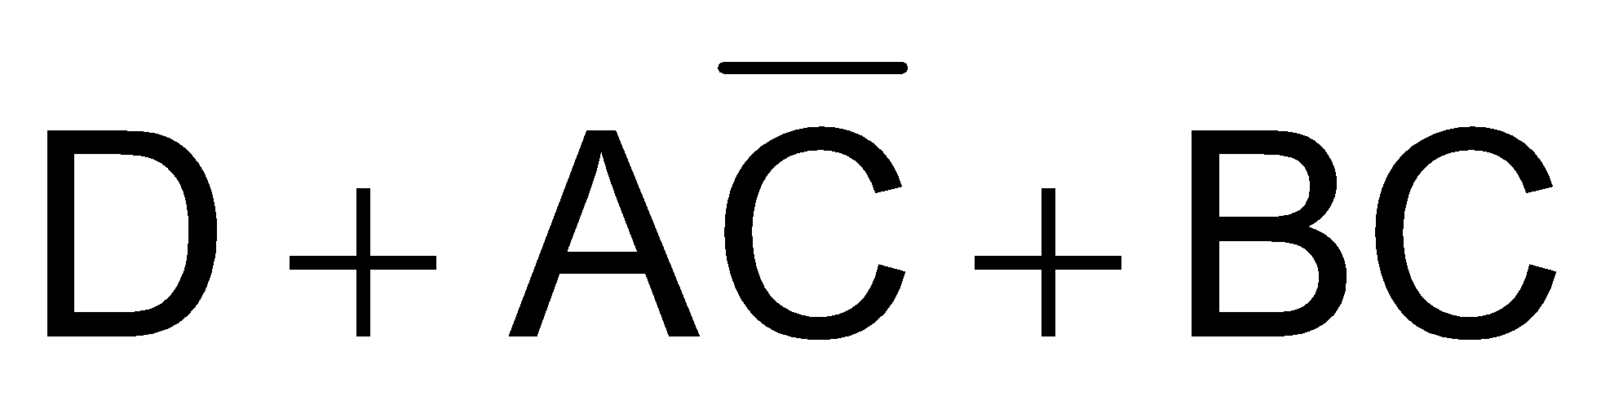
Mapping of Non-Standard SOP expression
SOP expression
AB\CD | 00 | 01 | 11 | 10
00
01
11
10
Notes:
‹#›
Consider a 4-variable non-standard SOP expression D+AC*+BC
A 4-variable K-map is used to map the expression as the SOP expression has a domain of 4 variables.
The non-standard product term D is mapped first.
The K-map cells having the product term D are marked with 1s.
The 8 cells marked 1, 3, 5, 7, 9, 11, 13 and 15 all have the D product term therefore they are marked with 1s.

Slide 23
Mapping of Non-Standard SOP expression
SOP expression
AB\CD | 00 | 01 | 11 | 10
00 |  | 1 | 1
01 |  | 1 | 1
11 |  | 1 | 1
10 |  | 1 | 1
Notes:
‹#›
Consider a 4-variable non-standard SOP expression D+AC*+BC
A 4-variable K-map is used to map the expression as the SOP expression has a domain of 4 variables.
The non-standard product term D is mapped first.
The K-map cells having the product term D are marked with 1s.
The 8 cells marked 1, 3, 5, 7, 9, 11, 13 and 15 all have the D product term therefore they are marked with 1s.

Slide 24
Mapping of Non-Standard SOP expression
SOP expression
AB\CD | 00 | 01 | 11 | 10
00 |  | 1 | 1
01 |  | 1 | 1
11 |  | 1 | 1
10 |  | 1 | 1
Notes:
‹#›
The non-standard product term AC* is mapped next.
Using the same k-map
The cells marked 8, 9, 12 and 13 are marked with 1s.
As all four cells have the variable AC*
It is possible that multiple terms are present in the same cell, such as the terms D and AC*in cells 9 and 13.
Presence of multiple terms in a single cell is marked by a single 1.

Slide 25
Mapping of Non-Standard SOP expression
SOP expression
AB\CD | 00 | 01 | 11 | 10
00 |  | 1 | 1
01 |  | 1 | 1
11 | 1 | 1 | 1
10 | 1 | 1 | 1
Notes:
‹#›
Finally, the third non-standard product term BC is mapped.
Using the same k-map
The cells marked 6, 7, 14 and 15 are marked with 1s.
All four cells have the variable BC
Remaining cells are marked with 0s.
Again, presence of multiple terms in a single cell is marked by a single 1.

Slide 26
Mapping of Non-Standard SOP expression
SOP expression
AB\CD | 00 | 01 | 11 | 10
00 |  | 1 | 1
01 |  | 1 | 1
11 | 1 | 1 | 1
10 | 1 | 1 | 1
Notes:
‹#›
Finally, the third non-standard product term BC is mapped.
Using the same k-map
The cells marked 6, 7, 14 and 15 are marked with 1s.
All four cells have the variable BC
Remaining cells are marked with 0s.
Again, presence of multiple terms in a single cell is marked by a single 1.

Slide 27
Mapping of Non-Standard SOP expression
SOP expression
AB\CD | 00 | 01 | 11 | 10
00 |  | 1 | 1
01 |  | 1 | 1 | 1
11 | 1 | 1 | 1 | 1
10 | 1 | 1 | 1
Notes:
‹#›
Finally, the third non-standard product term BC is mapped.
Using the same k-map
The cells marked 6, 7, 14 and 15 are marked with 1s.
All four cells have the variable BC
Remaining cells are marked with 0s.
Again, presence of multiple terms in a single cell is marked by a single 1.

Slide 28
Mapping of Non-Standard SOP expression
SOP expression
AB\CD | 00 | 01 | 11 | 10
00 | 0 | 1 | 1 | 0
01 | 0 | 1 | 1 | 1
11 | 1 | 1 | 1 | 1
10 | 1 | 1 | 1 | 0
Notes:
‹#›
Finally, the third non-standard product term BC is mapped.
Using the same k-map
The cells marked 6, 7, 14 and 15 are marked with 1s.
All four cells have the variable BC
Remaining cells are marked with 0s.
Again, presence of multiple terms in a single cell is marked by a single 1.

Slide 29
Simplification of SOP expressions using K-map
Mapping of expression
Forming of Groups of 1s
Each group represents product term
3-variable K-map
1 cell group yields a 3 variable product term
2 cell group yields a 2 variable product term
4 cell group yields a 1 variable product term
8 cell group yields a value of 1 for function

Slide 30
Simplification of SOP expressions using K-map
4-variable K-map
1 cell group yields a 4 variable product term
2 cell group yields a 3 variable product term
4 cell group yields a 2 variable product term
8 cell group yields a 1 variable product term
16 cell group yields a value of 1 for function
Notes:
‹#›

Slide 31
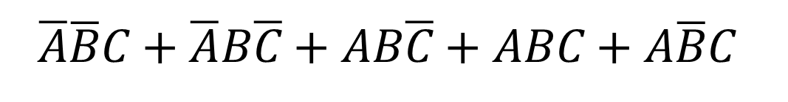
Simplification of SOP expressions using K-map
AB\C | 0 | 1
00 | 0 | 1
01 | 1 | 0
11 | 1 | 1
10 | 0 | 1
A\BC | 00 | 01 | 11 | 10
0 | 0 | 1 | 1 | 1
1 | 1 | 0 | 0 | 0
Notes:
‹#›
Consider the 3-variable column based K-map in which the SOP expression has been mapped.
The SOP expression has 5 minterms marked by 1s in the K-map.
Three groups of two cells each are formed.
The first group of 1s comprising of cells 2 and 6 forms the product term BC*
The second group of 1s comprising of cells 5 and 7 forms the product term AC
The third group of 1s comprising of cells 1 and 5 forms the product term B*C
The five term SOP expression simplifies to a 3 term SOP expression
Consider the 3-variable row based K-map in which the SOP expression has been mapped.
The SOP expression has 4 minterms marked as 1s in the K-map.
Two groups of 2 cells each and a third group of single cell are formed.
The single cell group comprising of cell 4 forms the product term AB*C*
The second group of 1s comprising of cells 1 and 3 forms the product term A*C
The third group of 1s comprising of cells 2 and 3 forms the product term A*B
The four term SOP simplifies to a 3 term SOP expression

Slide 32
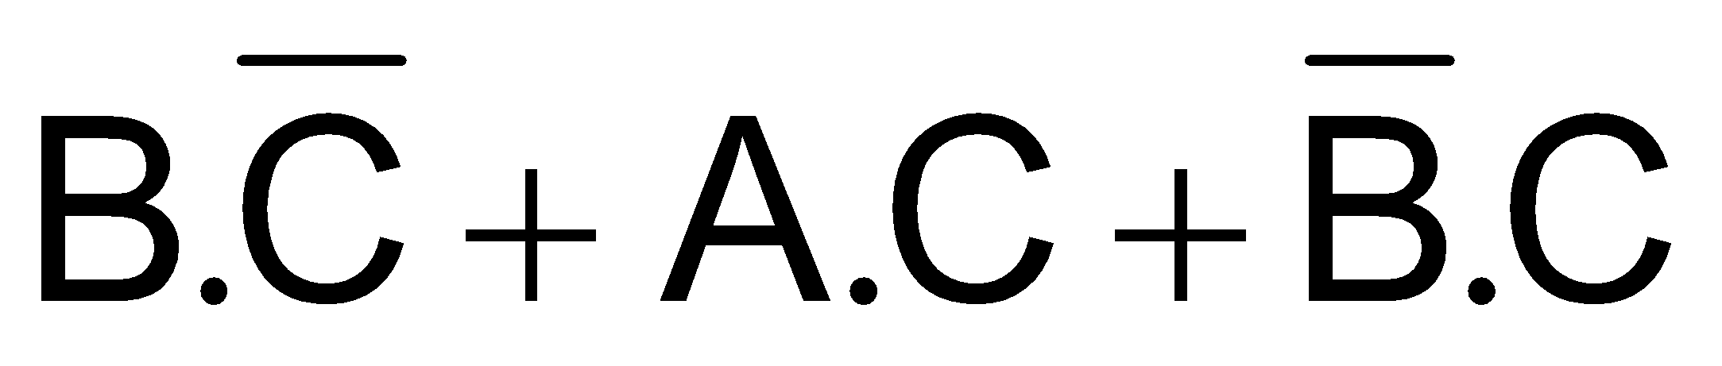
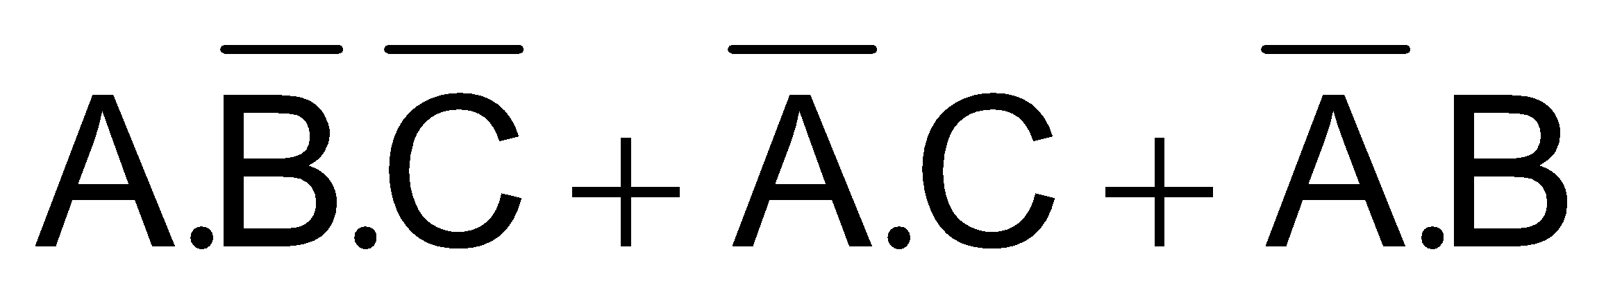
Simplification of SOP expressions using K-map
AB\C | 0 | 1
00 | 0 | 1
01 | 1 | 0
11 | 1 | 1
10 | 0 | 1
A\BC | 00 | 01 | 11 | 10
0 | 0 | 1 | 1 | 1
1 | 1 | 0 | 0 | 0
Notes:
‹#›
Consider the 3-variable column based K-map in which the SOP expression has been mapped.
The SOP expression has 5 minterms marked by 1s in the K-map.
Three groups of two cells each are formed.
The first group of 1s comprising of cells 2 and 6 forms the product term BC*
The second group of 1s comprising of cells 5 and 7 forms the product term AC
The third group of 1s comprising of cells 1 and 5 forms the product term B*C
The five term SOP expression simplifies to a 3 term SOP expression
Consider the 3-variable row based K-map in which the SOP expression has been mapped.
The SOP expression has 4 minterms marked as 1s in the K-map.
Two groups of 2 cells each and a third group of single cell are formed.
The single cell group comprising of cell 4 forms the product term AB*C*
The second group of 1s comprising of cells 1 and 3 forms the product term A*C
The third group of 1s comprising of cells 2 and 3 forms the product term A*B
The four term SOP simplifies to a 3 term SOP expression

Slide 33
Simplification of SOP expressions using K-map
SOP expression
AB\C | 0 | 1
00
01
11
10
A\BC | 00 | 01 | 11 | 10
0
1
Notes:
‹#›
Consider the 3-variable standard SOP expression ABC*+AB*C*+A*BC*
A 3-variable K-map is used to map the expression as the SOP expression has a domain of 3 variables.
What are the minterms in the SOP expression?
The Standard SOP expression has three minterms 2, 4 and 6.
The minterms present in the expression are mapped to the corresponding K-map cells.
The cells representing the three minterms are marked with 1s, remaining cells are marked with 0s.
Any of the two K-maps can be used

Slide 34
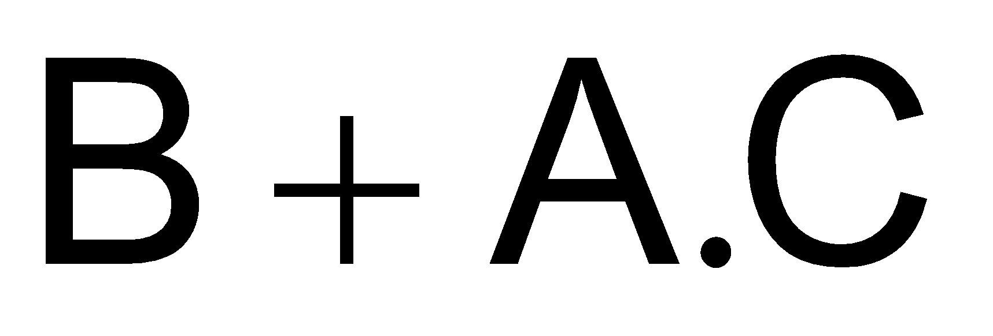
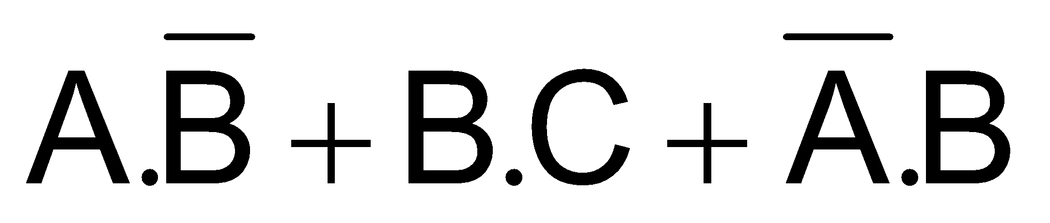
Simplification of SOP expressions using K-map
AB\C | 0 | 1
00 | 0 | 0
01 | 1 | 1
11 | 1 | 1
10 | 0 | 1
A\BC | 00 | 01 | 11 | 10
0 | 0 | 0 | 1 | 1
1 | 1 | 1 | 1 | 0
Notes:
‹#›
Consider the 3-variable column based K-map
Two groups of four cells and two cells each are formed respectively.
The first group of 1s comprising of cells 2, 3, 6 and 7 forms the product term B
The second group of 1s comprising of cells 5 and 7 forms the product term AC
Consider the 3-variable row based K-map.
Three groups of 2 cells each are formed.
The first group of 1s comprising of cell 4 and 5 forms the product term AB*
The second group of 1s comprising of cells 3 and 7 forms the product term BC
The third group of 1s comprising of cells 2 and 3 forms the product term A*B

Slide 35
Simplification of SOP expressions using K-map
Total minterms are 11
AB\CD | 00 | 01 | 11 | 10
00 | 0 | 1 | 1 | 0
01 | 0 | 0 | 1 | 1
11 | 1 | 1 | 1 | 1
10 | 1 | 1 | 1 | 0
Notes:
‹#›
Consider a 12 term SOP expression mapped on a 4-variable K-map.
Three groups of four cells are formed.
The first group of 1s comprising of cells 8, 9, 12 and 13 forms the product term AC*
The second group of 1s comprising of cells 1, 3, 9 and 11 forms the product term B*D
The third group of 1s comprising of cells 6, 7, 14 and 15 forms the product term BC
The SOP expression has simplified to a 3 term expression.

Slide 36
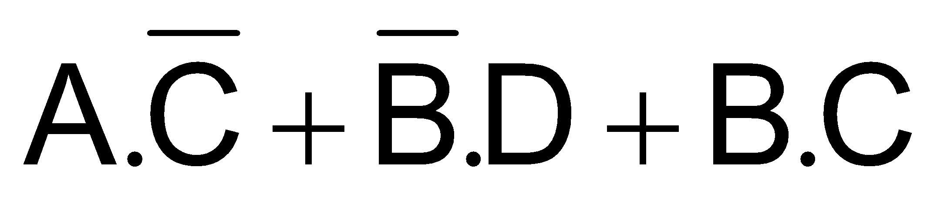
Simplification of SOP expressions using K-map
AB\CD | 00 | 01 | 11 | 10
00 | 0 | 1 | 1 | 0
01 | 0 | 0 | 1 | 1
11 | 1 | 1 | 1 | 1
10 | 1 | 1 | 1 | 0
Notes:
‹#›
Consider a 12 term SOP expression mapped on a 4-variable K-map.
Three groups of four cells are formed.
The first group of 1s comprising of cells 8, 9, 12 and 13 forms the product term AC*
The second group of 1s comprising of cells 1, 3, 9 and 11 forms the product term B*D
The third group of 1s comprising of cells 6, 7, 14 and 15 forms the product term BC
The SOP expression has simplified to a 3 term expression.

Slide 37
Simplification of SOP expressions using K-map
AB\CD | 00 | 01 | 11 | 10
00 | 0 | 0 | 1 | 0
01 | 0 | 0 | 1 | 1
11 | 1 | 0 | 1 | 1
10 | 1 | 0 | 1 | 0
Notes:
‹#›
Consider a 8 term SOP expression mapped to a 4 variable K-map.
One group of two cells and two groups of four cells are formed.
The first group of 1s comprising of cells 8 and 12 forms the product term AC*D*
The second group of 1s comprising of cells 3, 7, 11 and 15 forms the product term CD
The third group of 1s comprising of cells 6, 7, 14 and 15 forms the product term BC
The SOP expression has simplified to a 3 term SOP expression.

Slide 38
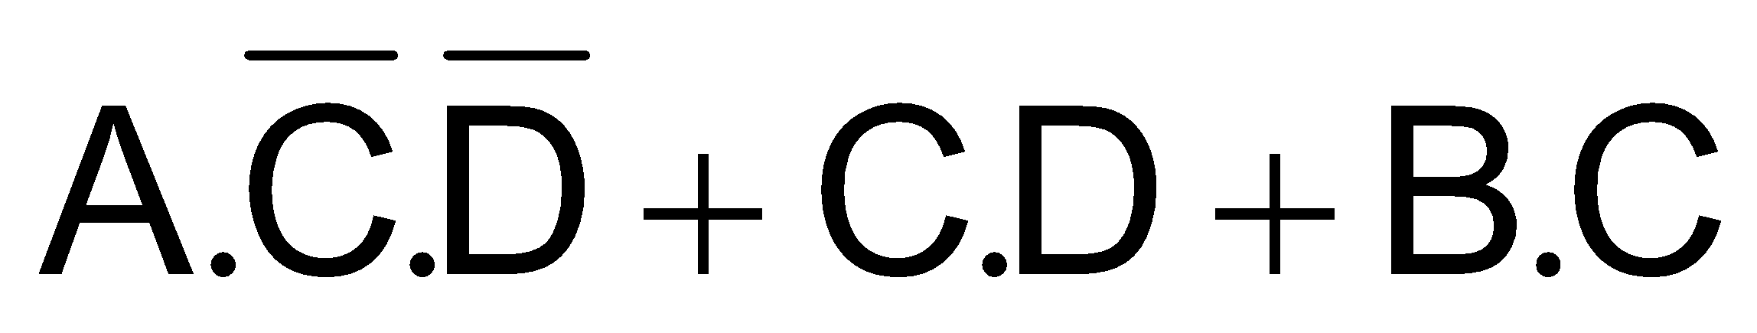
Simplification of SOP expressions using K-map
AB\CD | 00 | 01 | 11 | 10
00 | 0 | 0 | 1 | 0
01 | 0 | 0 | 1 | 1
11 | 1 | 0 | 1 | 1
10 | 1 | 0 | 1 | 0
Notes:
‹#›
Consider a 8 term SOP expression mapped to a 4 variable K-map.
One group of two cells and two groups of four cells are formed.
The first group of 1s comprising of cells 8 and 12 forms the product term AC*D*
The second group of 1s comprising of cells 3, 7, 11 and 15 forms the product term CD
The third group of 1s comprising of cells 6, 7, 14 and 15 forms the product term BC
The SOP expression has simplified to a 3 term SOP expression.

Slide 39
Simplification of SOP expressions using K-map
AB\CD | 00 | 01 | 11 | 10
00 | 1 | 0 | 1 | 1
01 | 0 | 0 | 0 | 1
11 | 0 | 1 | 1 | 0
10 | 1 | 0 | 1 | 1
Notes:
‹#›
Consider the 9 term SOP expression mapped to a 4-variable K-map.
Two group of two cells and two groups of four cells are formed.
The first group of 1s comprising of corner cells 0, 2, 8 and 10 forms the product term B*D*
The second group of 1s comprising of cells 2, 3, 10 and 11 forms the product term B*C
The third group of 1s comprising of cells 13 and 15 forms the product term ABD
The fourth group of 1s comprising of cells 2 and 6 forms the product term A*CD*
The SOP expression has simplified to a 4 term SOP expression.

Slide 40
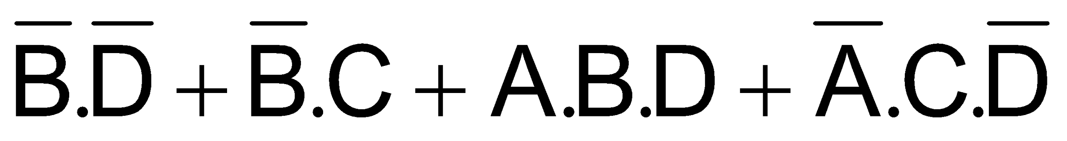
Simplification of SOP expressions using K-map
AB\CD | 00 | 01 | 11 | 10
00 | 1 | 0 | 1 | 1
01 | 0 | 0 | 0 | 1
11 | 0 | 1 | 1 | 0
10 | 1 | 0 | 1 | 1
Notes:
‹#›
Consider the 9 term SOP expression mapped to a 4-variable K-map.
Two group of two cells and two groups of four cells are formed.
The first group of 1s comprising of corner cells 0, 2, 8 and 10 forms the product term B*D*
The second group of 1s comprising of cells 2, 3, 10 and 11 forms the product term B*C
The third group of 1s comprising of cells 13 and 15 forms the product term ABD
The fourth group of 1s comprising of cells 2 and 6 forms the product term A*CD*
The SOP expression has simplified to a 4 term SOP expression.

Slide 41
Mapping Directly from Function Table
Function of a logic circuit defined by function table
Function can be directly mapped to K-map

Slide 42
Mapping Directly from Function Table
Odd-Prime Number Table
Inputs |  |  |  | Output
A | B | C | D | F
0 | 0 | 0 | 0 | 0
0 | 0 | 0 | 1 | 1
0 | 0 | 1 | 0 | 0
0 | 0 | 1 | 1 | 1
0 | 1 | 0 | 0 | 0
0 | 1 | 0 | 1 | 1
0 | 1 | 1 | 0 | 0
0 | 1 | 1 | 1 | 1
Inputs |  |  |  | Output
A | B | C | D | F
1 | 0 | 0 | 0 | 0
1 | 0 | 0 | 1 | 0
1 | 0 | 1 | 0 | 0
1 | 0 | 1 | 1 | 1
1 | 1 | 0 | 0 | 0
1 | 1 | 0 | 1 | 1
1 | 1 | 1 | 0 | 0
1 | 1 | 1 | 1 | 0
Notes:
‹#›
Consider a logical circuit that accepts 4-bit binary numbers representing decimal numbers 0 to 15.
The circuit checks the four bit binary equivalent of the decimal number.
If the number is odd and it is a prime number the function outputs a one.
Before designing the logic circuit a function table is implemented with all the input output combinations.
The function table for the odd prime number checker is shown.
The output is a 1 for inputs 1, 3, 5, 7, 11 and 13.

Slide 43
Mapping Directly from Function Table
AB\CD | 00 | 01 | 11 | 10
00 | 0 | 1 | 1 | 0
01 | 0 | 1 | 1 | 0
11 | 0 | 1 | 0 | 0
10 | 0 | 0 | 1 | 0
Notes:
‹#›
The 4-variable function table is directly mapped to a 4-variable K-map’
Each of the 16 minterm values in the function table are mapped to the corresponding minterm cells of the K-map.
Simplifying using the K-map gives 3 product terms which can be directly implemented using logic gates to form a odd prime number checker circuit.

Slide 44
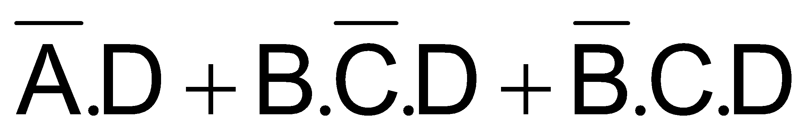
Mapping Directly from Function Table
AB\CD | 00 | 01 | 11 | 10
00 | 0 | 1 | 1 | 0
01 | 0 | 1 | 1 | 0
11 | 0 | 1 | 0 | 0
10 | 0 | 0 | 1 | 0
Notes:
‹#›
The 4-variable function table is directly mapped to a 4-variable K-map’
Each of the 16 minterm values in the function table are mapped to the corresponding minterm cells of the K-map.
Simplifying using the K-map gives 3 product terms which can be directly implemented using logic gates to form a odd prime number checker circuit.

Slide 45
Don’t care Conditions
Some input combinations never occur
Outputs are assumed to be don’t care
Don’t care outputs used as 0 or 1 during simplification.
Results in simpler and shorter expressions

Slide 46
Don’t Care Conditions
Inputs |  |  |  | Output
A | B | C | D | F
0 | 0 | 0 | 0 | 0
0 | 0 | 0 | 1 | 1
0 | 0 | 1 | 0 | 0
0 | 0 | 1 | 1 | 1
0 | 1 | 0 | 0 | 0
0 | 1 | 0 | 1 | 1
0 | 1 | 1 | 0 | 0
0 | 1 | 1 | 1 | 1
Inputs |  |  |  | Output
A | B | C | D | F
1 | 0 | 0 | 0 | 0
1 | 0 | 0 | 1 | 1
1 | 0 | 1 | 0 | X
1 | 0 | 1 | 1 | X
1 | 1 | 0 | 0 | X
1 | 1 | 0 | 1 | X
1 | 1 | 1 | 0 | X
1 | 1 | 1 | 1 | X
Notes:
‹#›
Consider the number checker circuit that only checks for the odd prime numbers between 0 and 9
To modify the operation of the number checker circuit the function table is modified to show don’t care output states for the inputs 10 to 15.

Slide 47
Don’t Care Conditions
AB\CD | 00 | 01 | 11 | 10
00 | 0 | 1 | 1 | 0
01 | 0 | 1 | 1 | 0
11 | x | x | x | x
10 | 0 | 1 | x | x
Notes:
‹#›
The 4-variable function table is directly mapped to a 4-variable K-map’
Each of the 16 minterm values in the function table are mapped to the corresponding minterm cells of the K-map, including the don’t care states.
In this particular case all the don’t care states are assumed to be 0s. The K-map simplification leads to the expression A*D.
Assuming that the circuit checks for odd prime numbers for the first 9 numbers ranging from 0 to 8, the remaining combinations never occur.
The function table is modified to include a don’t care state for the input combination 1001.
Mapping the function table to a 4-variable K-map leads to 7 cells having don’t care state.
The cells
Simplifying using the K-map gives 3 product terms which can be directly implemented using logic gates to form a odd prime number checker circuit.

Slide 48

Don’t Care Conditions
AB\CD | 00 | 01 | 11 | 10
00 | 0 | 1 | 1 | 0
01 | 0 | 1 | 1 | 0
11 | x | x | x | x
10 | 0 | 1 | x | x
Notes:
‹#›
The 4-variable function table is directly mapped to a 4-variable K-map’
Each of the 16 minterm values in the function table are mapped to the corresponding minterm cells of the K-map, including the don’t care states.
In this particular case all the don’t care states are assumed to be 0s. The K-map simplification leads to the expression A*D.
Assuming that the circuit checks for odd prime numbers for the first 9 numbers ranging from 0 to 8, the remaining combinations never occur.
The function table is modified to include a don’t care state for the input combination 1001.
Mapping the function table to a 4-variable K-map leads to 7 cells having don’t care state.
The cells
Simplifying using the K-map gives 3 product terms which can be directly implemented using logic gates to form a odd prime number checker circuit.

Slide 49

Don’t Care Conditions
AB\CD | 00 | 01 | 11 | 10
00 | 0 | 1 | 1 | 0
01 | 0 | 1 | 1 | 0
11 | x | x | x | x
10 | 0 | x | x | x
Notes:
‹#›
Assuming that the circuit checks for odd prime numbers for the first 9 numbers ranging from 0 to 8, the remaining combinations never occur.
The function table is modified to include a don’t care state for the input combination 1001.
Mapping the function table to a 4-variable K-map leads to 7 cells having don’t care state.
The 4 cells 9, 11, 13 and 15 marked with x indicate the don’t care state are assumed to be 1s.
Forming a group of 8 adjacent cells comprising cells 1, 3, 5, 7, 9, 11, 13 and 15 result in the simplest expression D

